Slide 2
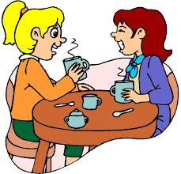
Unit
7
TRAFFIC
LESSON 4: COMMUNICATION
Unit
HOBBIES

Slide 3
OBJECTIVES
By the end of the lesson, students will be able to:
learn how to ask and answer about means of transport and some strange traffic rules.
practise using some grammar points and vocabulary related to the topic.

Slide 4
LESSON 4: COMMUNICATION
WARM-UP
Game: BRAINSTORMING
Everyday English
Task 1: Listen and read the conversation, paying attention to the highlighted parts.
Task 2: Work in pairs. Take turns to ask and answer about the means of transport your family members use every day.
Strange traffic rules!
Task 3: Which countries below keep to the left? Tick the correct answers.
Task 4: Listen and check your answers in 3. Then listen again and complete the sentence with no more than THREE words
EVERYDAY ENGLISH
STRANGE TRAFFIC RULES
PRODUCTION
Task 5: Read, discuss which one do is the strangest rule?
CONSOLIDATION
Wrap-up
Home work

Slide 5
LESSON 2: A CLOSER LOOK 1
WARM-UP
Game: Brainstorming
Aims of the stage:
To lead in the lesson

Slide 6
WARM-UP
HOW DO YOU GO TO SCHOOL?

Slide 7
LESSON 4: COMMUNICATION
WARM-UP
Game: BRAINSTORMING
Everyday English
Task 1: Listen and read the conversation, paying attention to the highlighted parts.
Task 2: Work in pairs. Take turns to ask and answer about the means of transport your family members use every day.
Strange traffic rules!
Task 3: Which countries below keep to the left? Tick the correct answers.
Task 4: Listen and check your answers in 3. Then listen again and complete the sentence with no more than THREE words
EVERYDAY ENGLISH
STRANGE TRAFFIC RULES

Slide 8
PRACTICE
1
Everyday English
Aims of the stage:
To let students know the structure to ask and answer about means of transport.

Slide 9
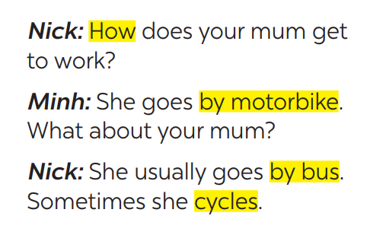
PRESENTATION
1
Listen and read the conversation, paying attention to the highlighted parts.
Which tense do we use to ask and answer?
Which question word do we use?

Slide 10
PRESENTATION
STRUCTURES
HOW +DO/DOES + S + GO TO …?
S + GO/GOES TO … BY …

Slide 11
LESSON 4: COMMUNICATION
WARM-UP
Game: BRAINSTORMING
Everyday English
Task 1: Listen and read the conversation, paying attention to the highlighted parts.
Task 2: Work in pairs. Take turns to ask and answer about the means of transport your family members use every day.
Strange traffic rules!
Task 3: Which countries below keep to the left? Tick the correct answers.
Task 4: Listen and check your answers in 3. Then listen again and complete the sentence with no more than THREE words
EVERYDAY ENGLISH
STRANGE TRAFFIC RULES

Slide 12
PRACTICE
1
Everyday English
Aims of the stage:
To help students practise on how to ask and answer about means of transport.

Slide 13
PRACTICE
2
Work in pairs. Take turns to ask and answer about the means of transport your family members use every day.
How does your father
go to school?
He usually drives his car but sometimes he goes by bus.
How about your father?
He walks because we live near his office.

Slide 14
LESSON 4: COMMUNICATION
WARM-UP
Game: BRAINSTORMING
Everyday English
Task 1: Listen and read the conversation, paying attention to the highlighted parts.
Task 2: Work in pairs. Take turns to ask and answer about the means of transport your family members use every day.
Strange traffic rules!
Task 3: Which countries below keep to the left? Tick the correct answers.
Task 4: Listen and check your answers in 3. Then listen again and complete the sentence with no more than THREE words
EVERYDAY ENGLISH
STRANGE TRAFFIC RULES

Slide 15
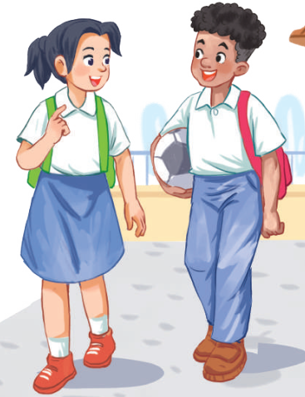
PRACTICE
STRANGE TRAFFIC RULES
Aims of the stage:
To provide students with more knowledge about strange traffic rules and help them practice the skill of listening for details

Slide 16
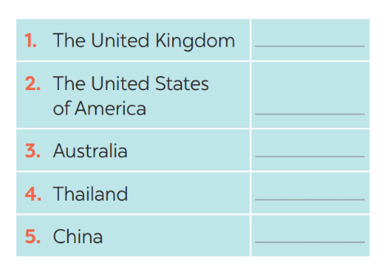
PRACTICE
3
Which countries below keep to the left? Tick the correct answers.

Slide 17
PRACTICE
4
Listen and check your answers in 3. Then listen again and complete the sentence with no more than THREE words.
One explanation is that some countries use ____________________________ as the UK.
same traffic rules

Slide 18
LESSON 4: COMMUNICATION
WARM-UP
Game: BRAINSTORMING
Everyday English
Task 1: Listen and read the conversation, paying attention to the highlighted parts.
Task 2: Work in pairs. Take turns to ask and answer about the means of transport your family members use every day.
Strange traffic rules!
Task 3: Which countries below keep to the left? Tick the correct answers.
Task 4: Listen and check your answers in 3. Then listen again and complete the sentence with no more than THREE words
EVERYDAY ENGLISH
STRANGE TRAFFIC RULES
PRODUCTION
Task 5: Read, discuss which one do is the strangest rule?

Slide 19
PRODUCTION
Aims of the stage:
To help students know more about traffic rules around the world.

Slide 20
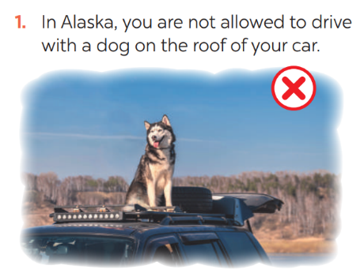
PRODUCTION
5
Read, discuss which one do is the strangest rule?

Slide 21
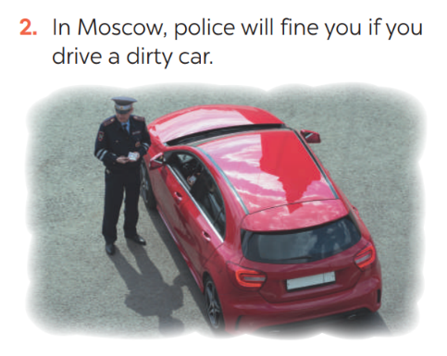
PRODUCTION
5
Read, discuss which one do is the strangest rule?

Slide 22
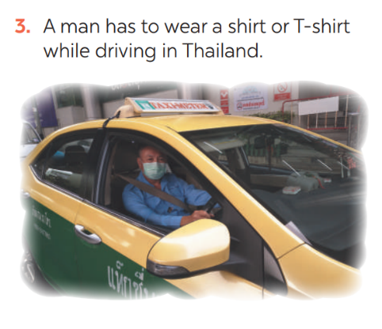
PRODUCTION
5
Read, discuss which one do is the strangest rule?

Slide 23
PRODUCTION
5
Read, discuss which one do is the strangest rule?

Slide 24
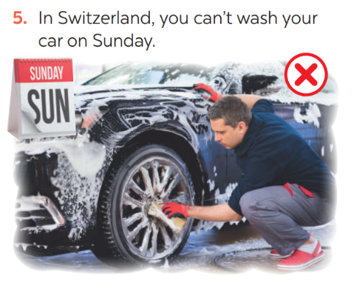
PRODUCTION
5
Read, discuss which one do is the strangest rule?

Slide 25
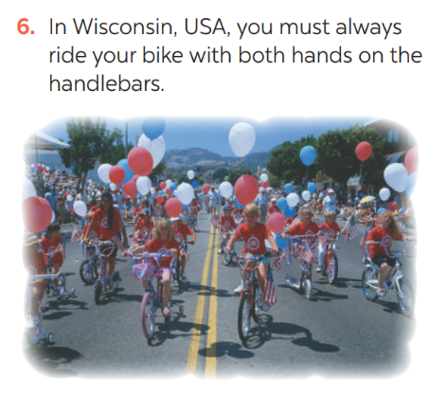
PRODUCTION
5
Read, discuss which one do is the strangest rule?

Slide 26
CONSOLIDATION
1
WRAP-UP
In this lesson, we have learn to:
ask and answer about means of transport and some strange traffic rules.
practise using some grammar points and vocabulary related to the topic.

Slide 27
CONSOLIDATION
2
HOMEWORK
Do exercises in the workbook.

